Slide 1
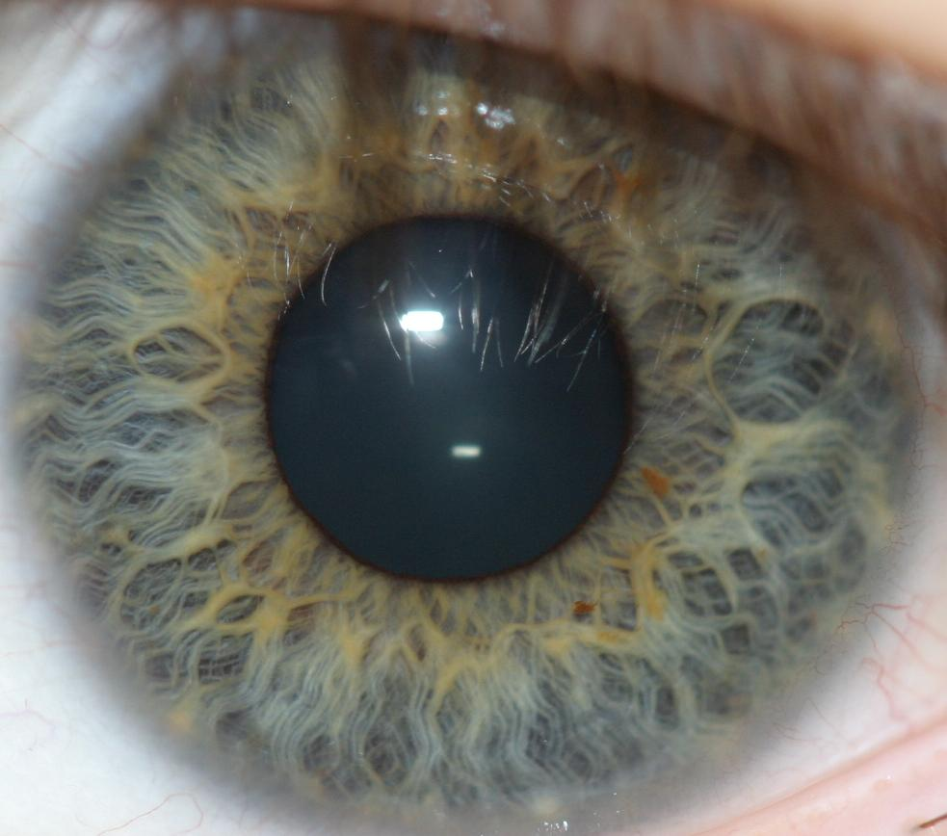
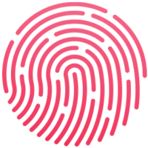
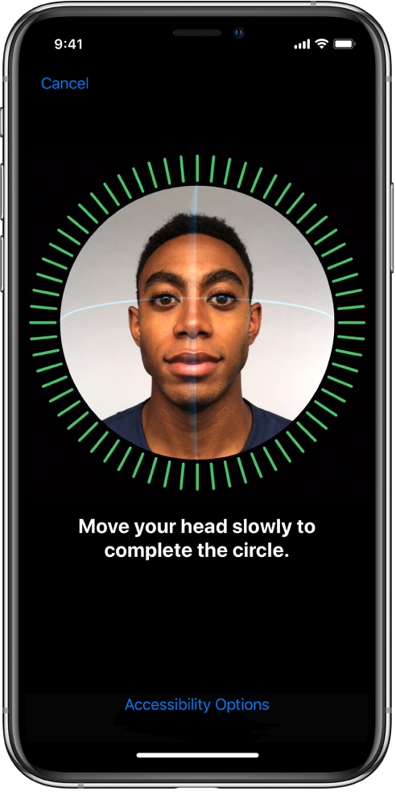
Biometric AUTHENTICATION Vitaly Shmatikov

Slide 2
Biometric Authentication
Nothing to remember
Passive
Nothing to type, no devices to carry around
Can’t share (usually)
Can be fairly unique
… if measurements are sufficiently accurate

Slide 3
Identification vs. Authentication
Identification: associate an identity with an event
Example: a fingerprint at a crime scene
Key question: given a particular biometric reading, does there exist another person who has the same value of this biometric?
Authentication: verify a claimed identity
Example: fingerprint scanner to enter a building
Key question: do there exist any two persons who have the same value of this biometric?
Collisions are more frequent than you might think (birthday paradox!)

Slide 4
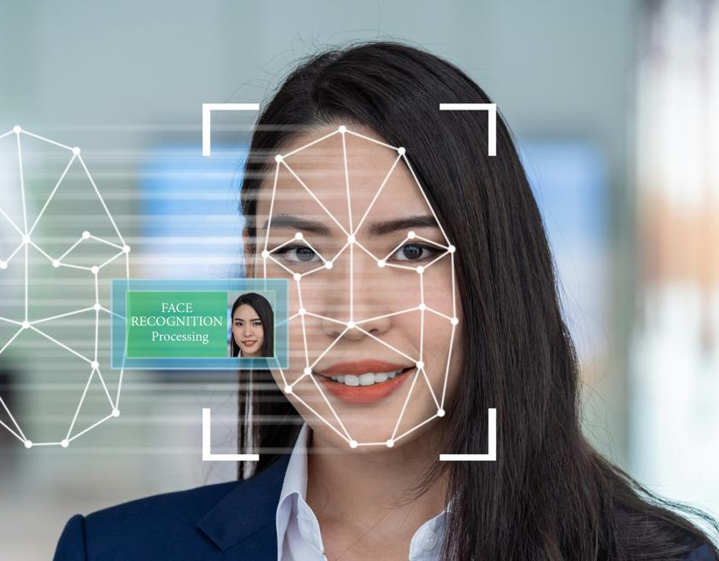
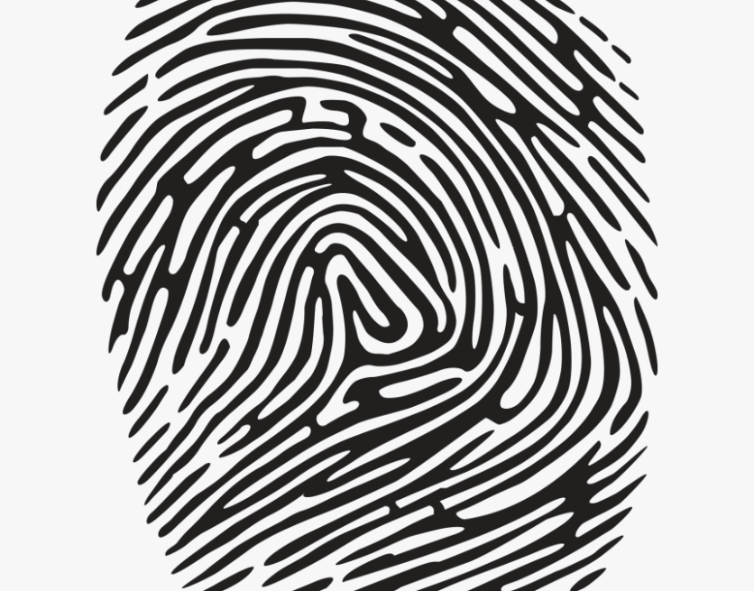
Biometrics (1)
Face recognition (by a computer algorithm)
Error rates up to 20%, given reasonable variations in lighting, viewpoint, expression
Fingerprints
Traditional method for identification
1911: first US conviction on fingerprint evidence
U.K. traditionally requires 16-point match
Probability of a false match is 1 in 10 billion
No successful challenges until 2000
Fingerprint damage impairs recognition
Ross Anderson’s scar crashes FBI scanner

Slide 5
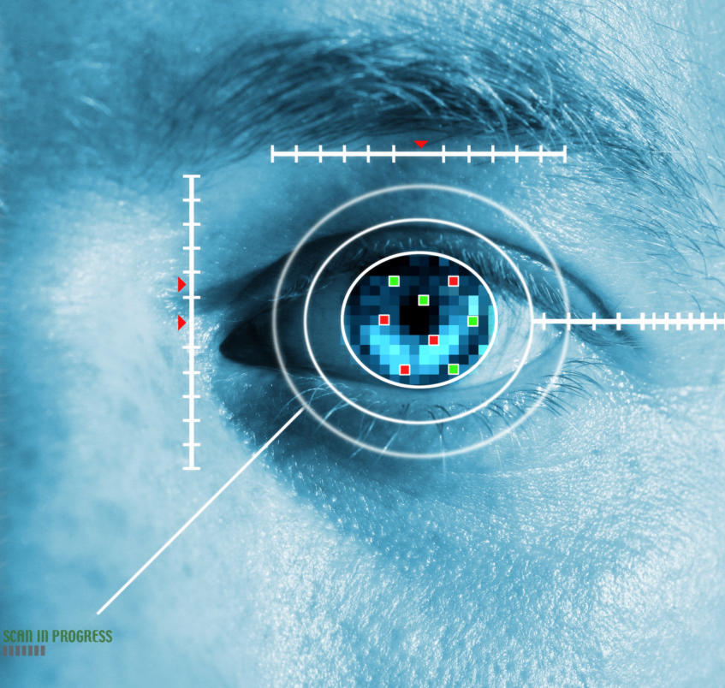
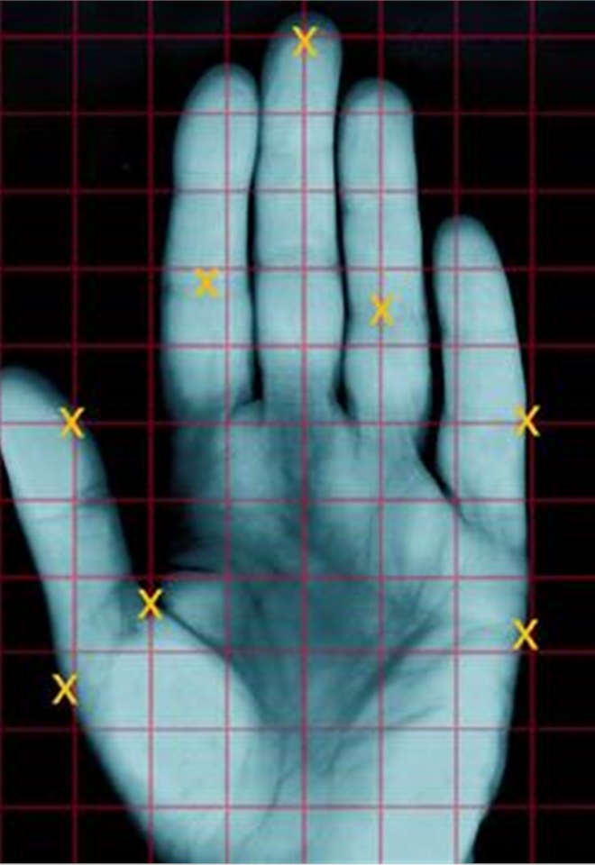

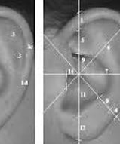
Biometrics (2)
Iris scanning
Irises are very random (different even in the same individual), but stable through life
256-byte iris code based on concentric rings between the pupil and the outside of the iris
Equal error rate better than 1 in a million
Hand geometry
Nuclear premises entry control
Voice, ear shape, vein pattern, face temp

Slide 6
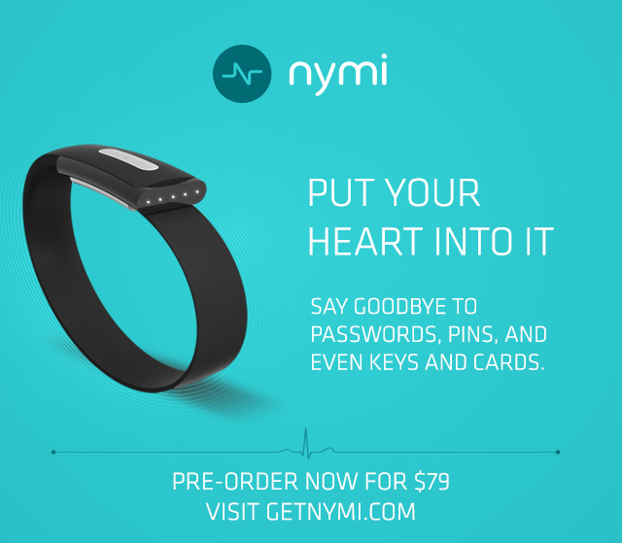
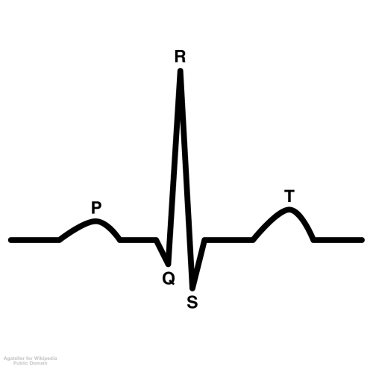
Biometrics (3)
Identifies wearer
by his/her unique
heartbeat pattern

Slide 7
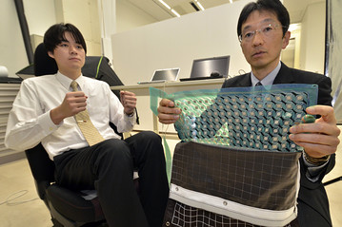
Biometrics (4)
“All you need to do is sit”
“Forget Fingerprints:
Car Seat IDs Driver’s Rear End”
360 disc-shaped sensors identify a unique “buttprint” with 98% accuracy
¥70,000
Advanced Institute of Industrial Technology, Japan

Slide 8
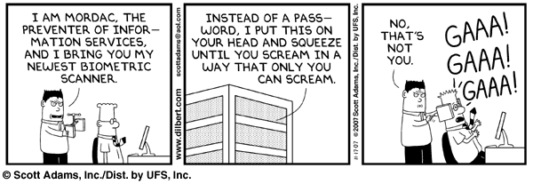
Biometrics (5)

Slide 9
Biometric Error Rates (Benign)
“Fraud rate” vs. “insult rate”
Fraud = system accepts a forgery (false accept)
Insult = system rejects valid user (false reject)
Increasing acceptance threshold increases fraud rate, decreases insult rate
For biometrics, U.K. banks set target fraud rate of 1%, insult rate of 0.01% [Ross Anderson]
Common signature recognition systems achieve equal error rates around 1% - not good enough!

Slide 10

Problems with Biometrics
Private, but not secret
Biometric passports, fingerprints and DNA on objects…
Even random-looking biometrics may not be sufficiently unique for authentication
Birthday paradox!
Potentially forgeable
Revocation is difficult or impossible

Slide 11
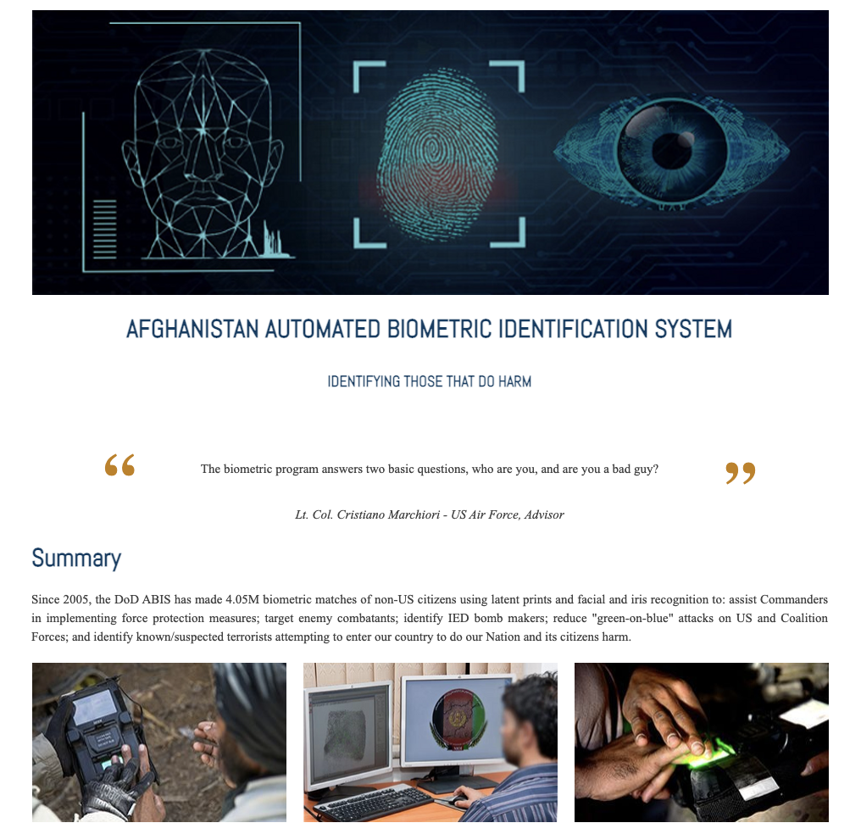
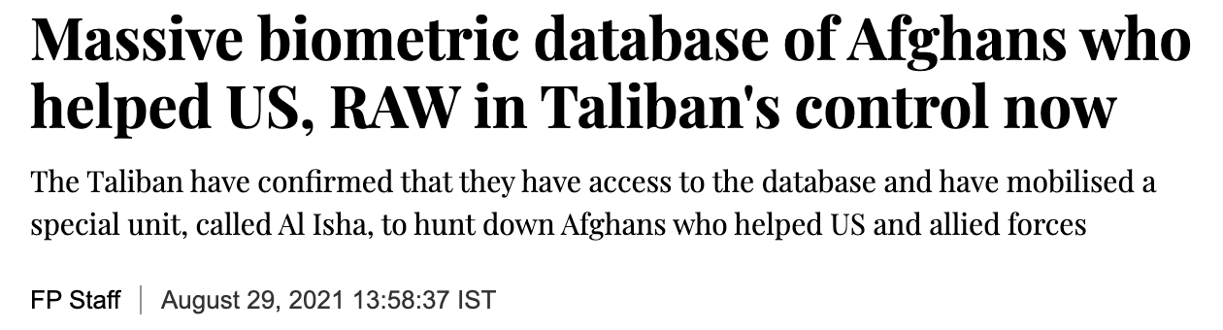

DoD system for biometric identification of terrorists -- and also Afghan civilians who worked for the coalition forces
https://www.firstpost.com/world/massive-biometric-database-of-persons-who-helped-us-nato-and-raw-in-taliban-control-now-say-reports-9921801.html

Slide 12
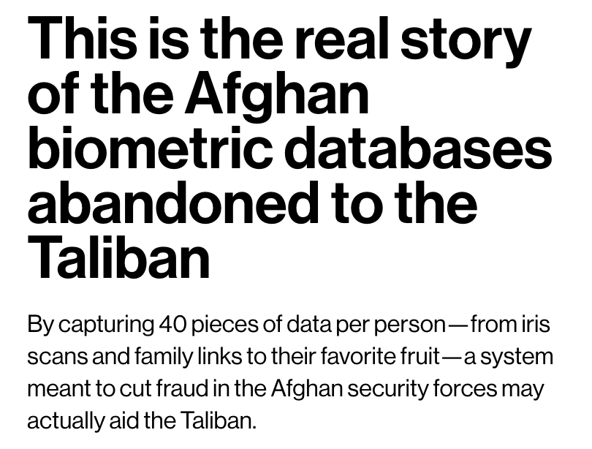
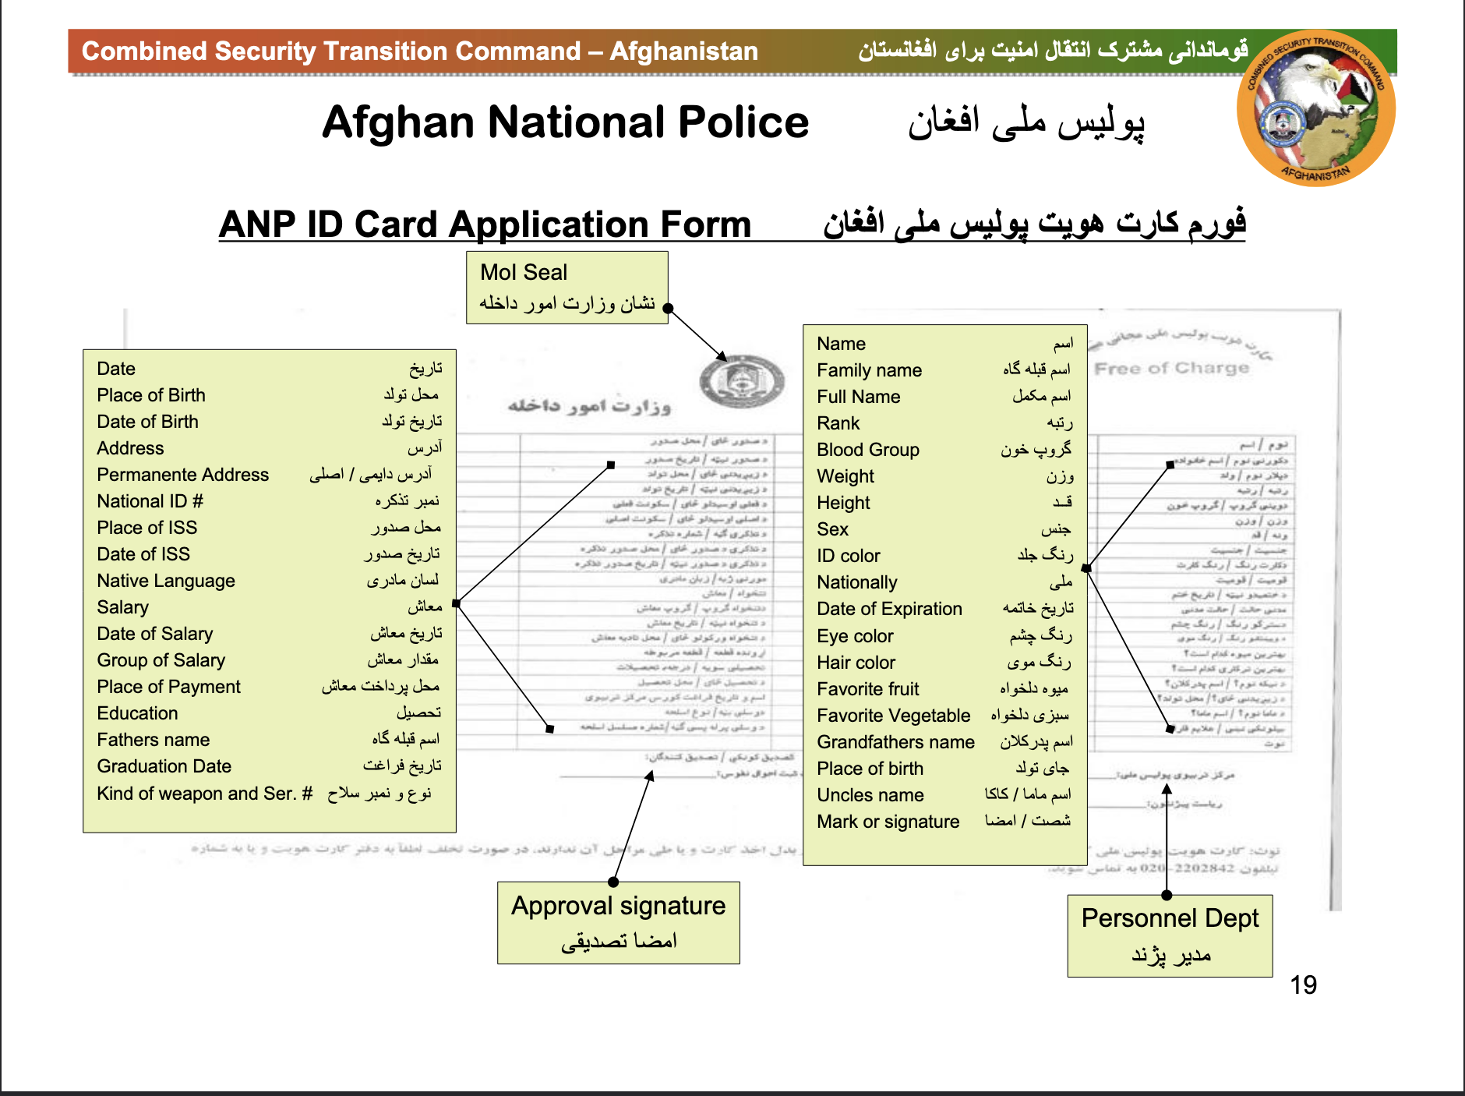
a US-funded database known as APPS, the Afghan Personnel and Pay System
…
The data is collected “from the day they enlisted,” says one individual who worked on the system, and remains in the system forever, whether or not someone remains actively in service
…
Our sources say that each profile in APPS holds at least 40 data fields. These include obvious personal information such as name, date, and place of birth, as well as a unique ID number that connects each profile to a biometric profile kept by the Afghan Ministry of Interior. But it also contains details on the individuals’ military specialty and career trajectory, as well as sensitive relational data such as the names of their father, uncles, and grandfathers, as well as the names of the two tribal elders per recruit who served as guarantors for their enlistment.
https://www.technologyreview.com/2021/08/30/1033941/afghanistan-biometric-databases-us-military-40-data-points/

Slide 13
Risks of Biometrics
Usability
Criminal gives an inexperienced policeman fingerprints in the wrong order: record not found; gets off as a first-time offender
Can be cloned or separated from the person
Ross Anderson: in countries where fingerprints are used to pay pensions, there are persistent tales of “Granny’s finger in the pickle jar” being the most valuable property she bequeathed to her family
False matches due to the birthday paradox
With the false accept rate of 1 in a million, probability of a false match is above 50% with only 1609 samples

Slide 14
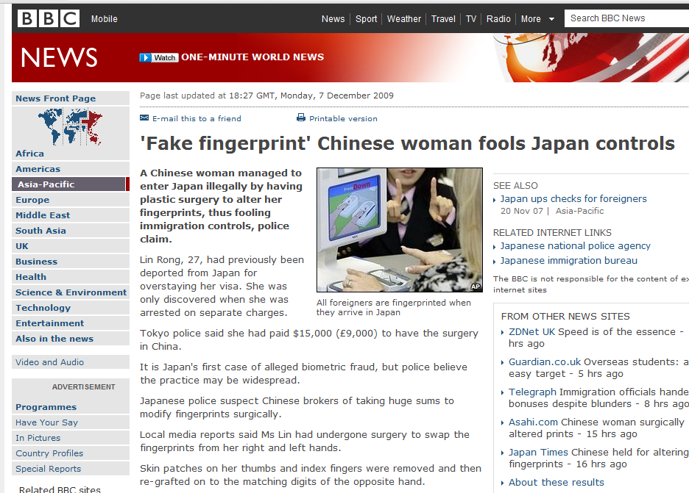
Surgical Change

Slide 15
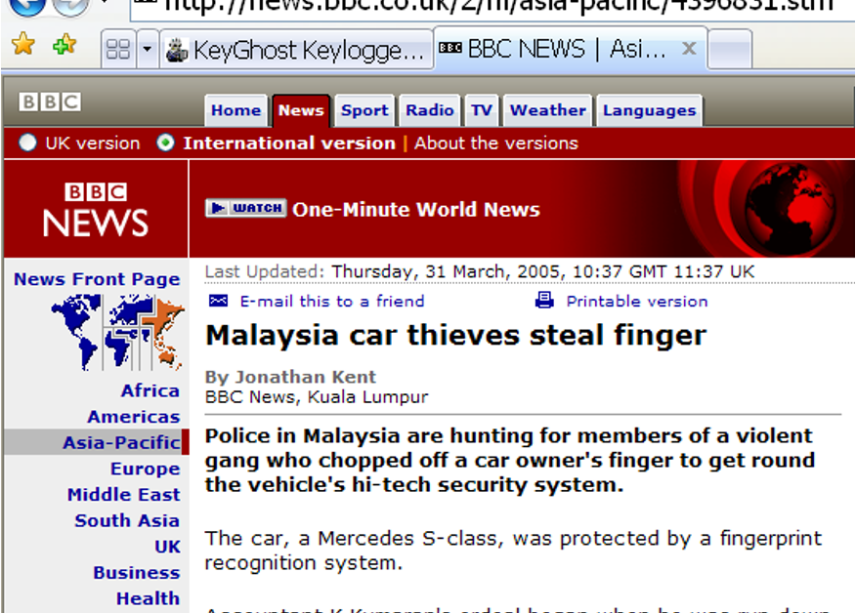
Theft

Slide 16
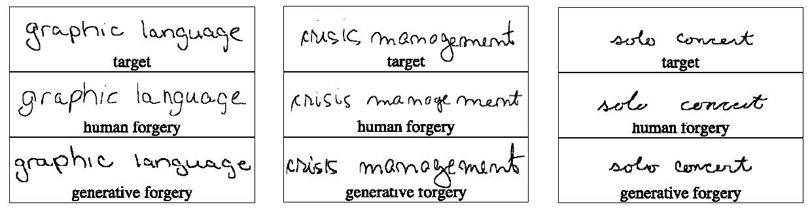
Generative Forgery
Generated by a computer algorithm trained on handwriting samples
Ballard, Monrose, Lopresti

Slide 17
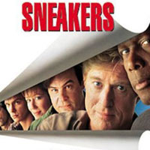
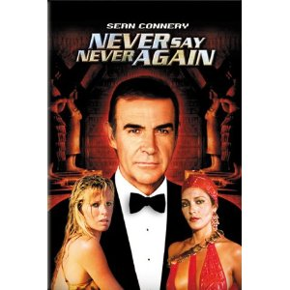
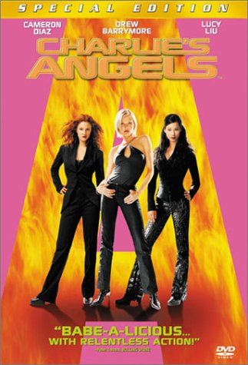
Involuntary Cloning
Clone a biometric without victim’s knowledge or assistance
“my voice is my
passport”
cloned retina
Fingerprints from beer bottles
Eye laser scan
Bad news: it works!

Slide 18
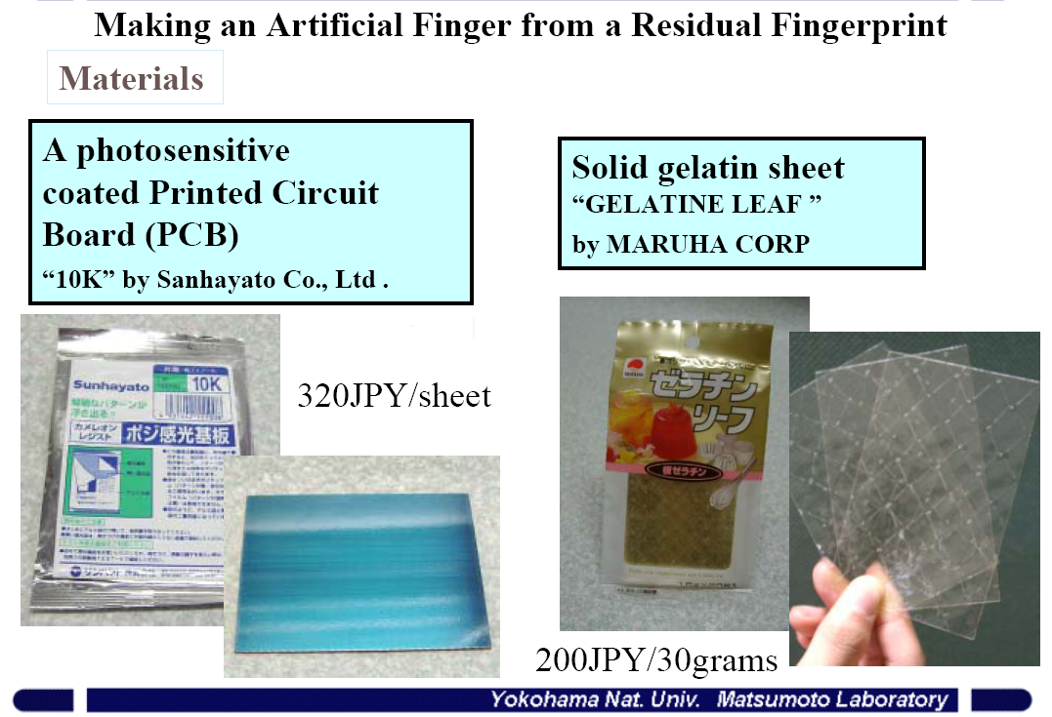
Cloning a Finger
Matsumoto

Slide 19
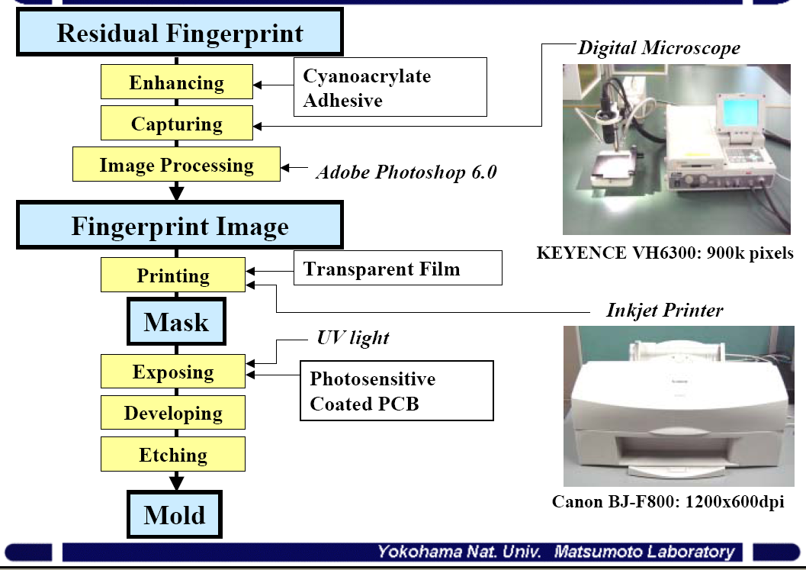
Cloning Process
Matsumoto

Slide 20
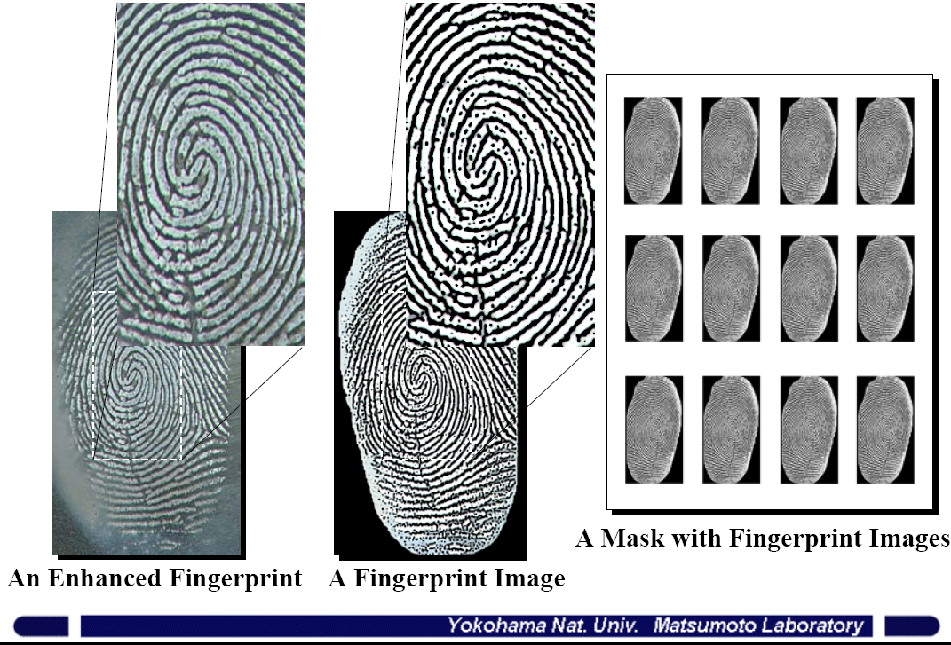
Fingerprint Image
Matsumoto

Slide 21
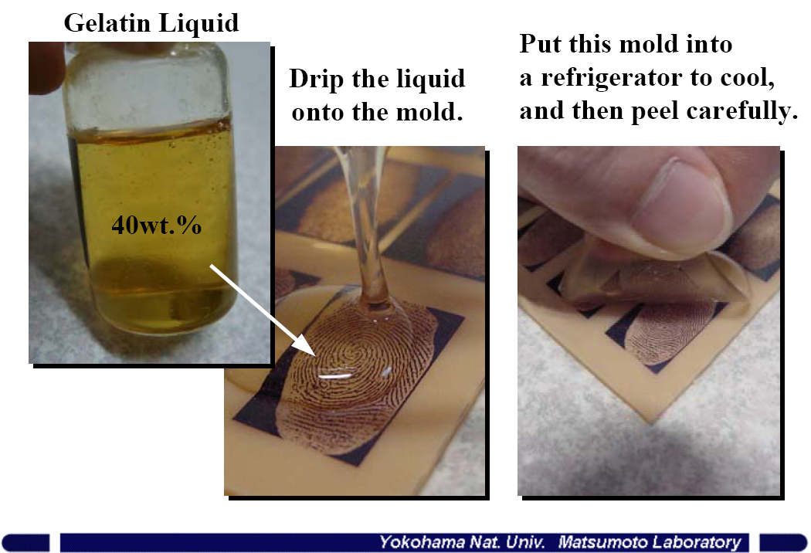
Molding
Matsumoto

Slide 22
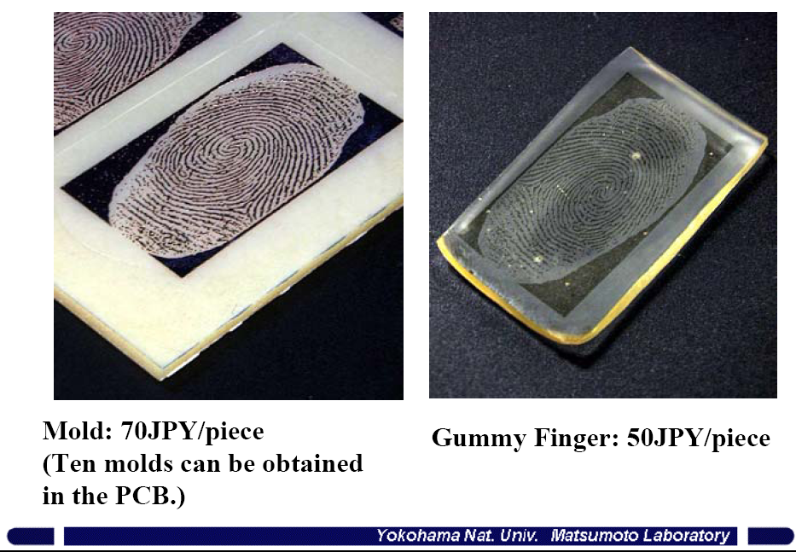
The Mold and the Gummy Finger
Matsumoto

Slide 23
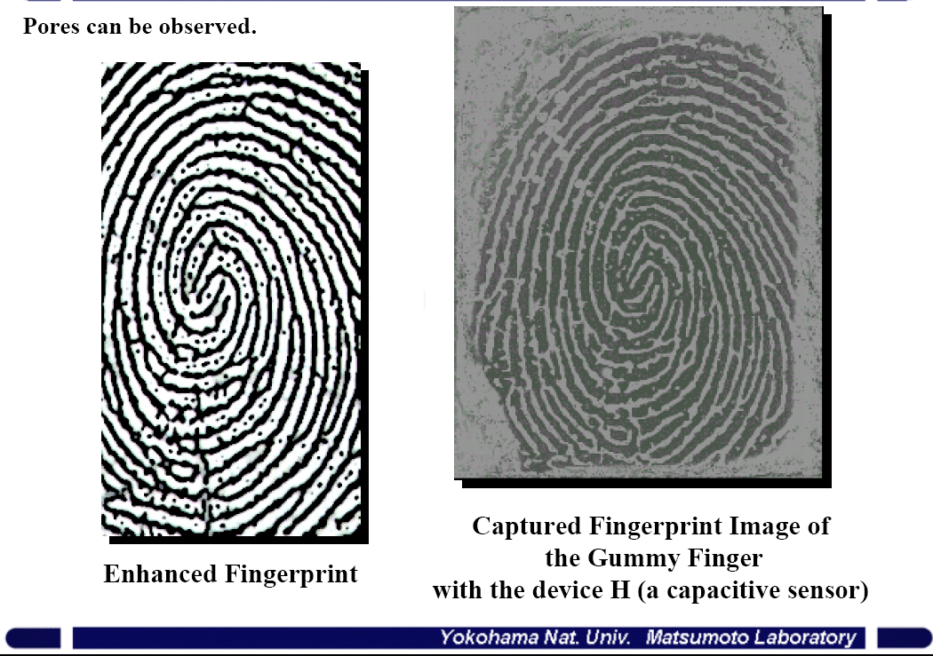
The Print and the Clone
Matsumoto

Slide 24
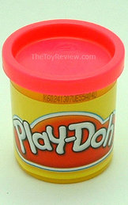
Play-Doh Fingers
Alternative to gelatin
Play-Doh fingers fool 90% of fingerprint scanners
Clarkson University study
Suggested perspiration measurement to test “liveness” of the finger
Schuckers

